Slide 1


FAME FURY
CONTRASTING REACTIONS TO US-BORN OLYMPIANS
Shehzad Ali (sha537)
Troy Richard (tdr944)
Neha Dipali (nd9975)
Soumi Basu (sb59982)

Slide 2


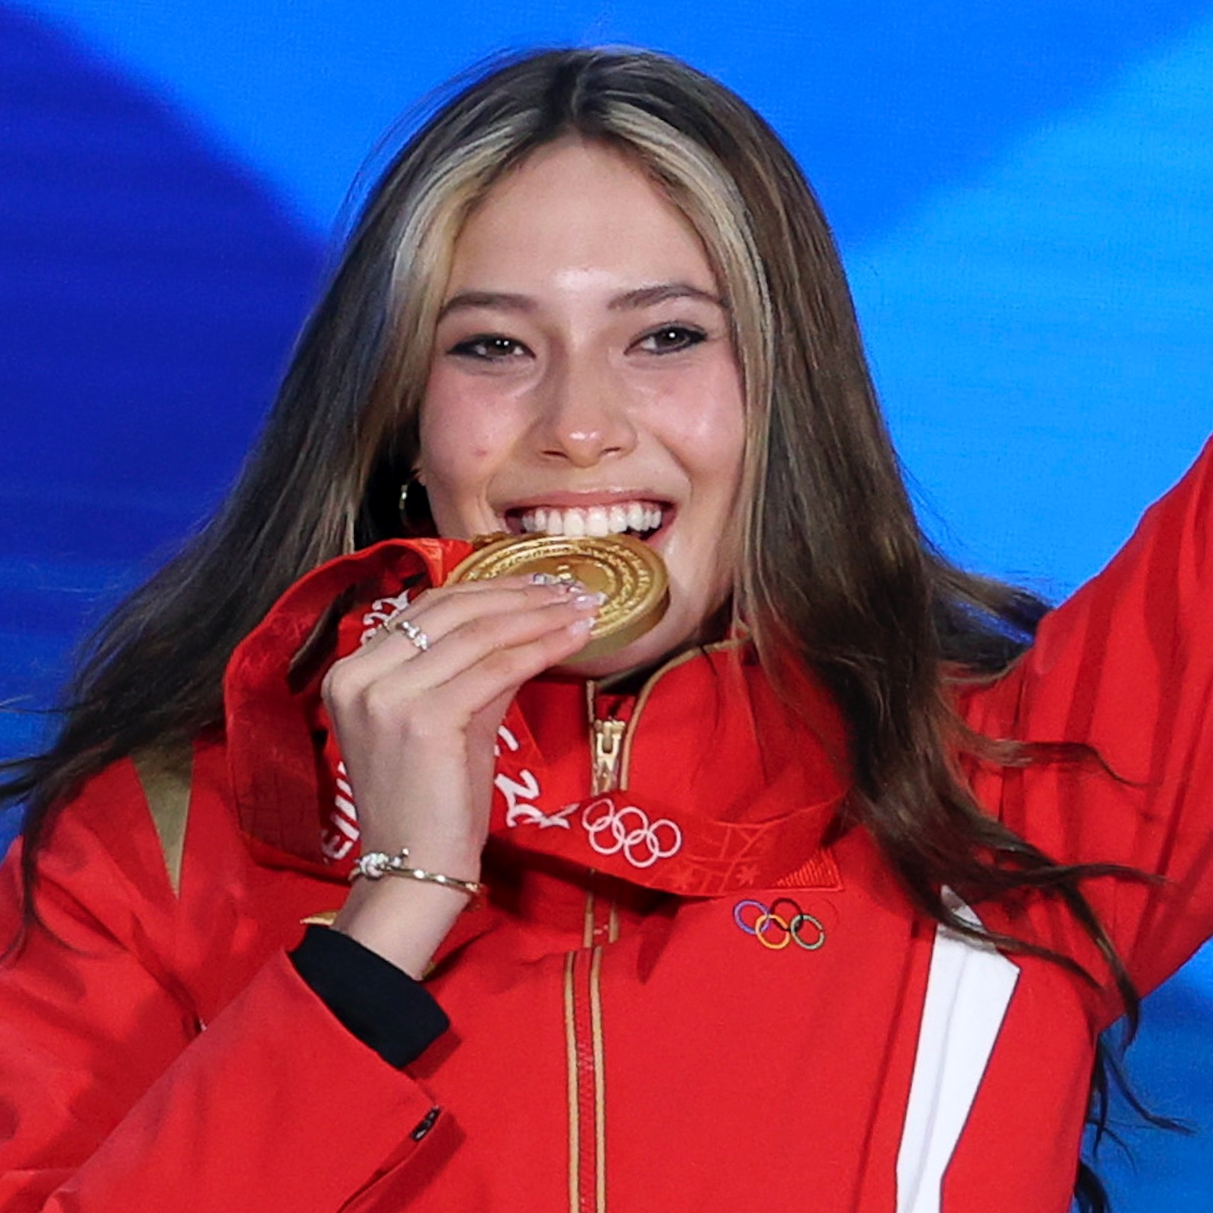
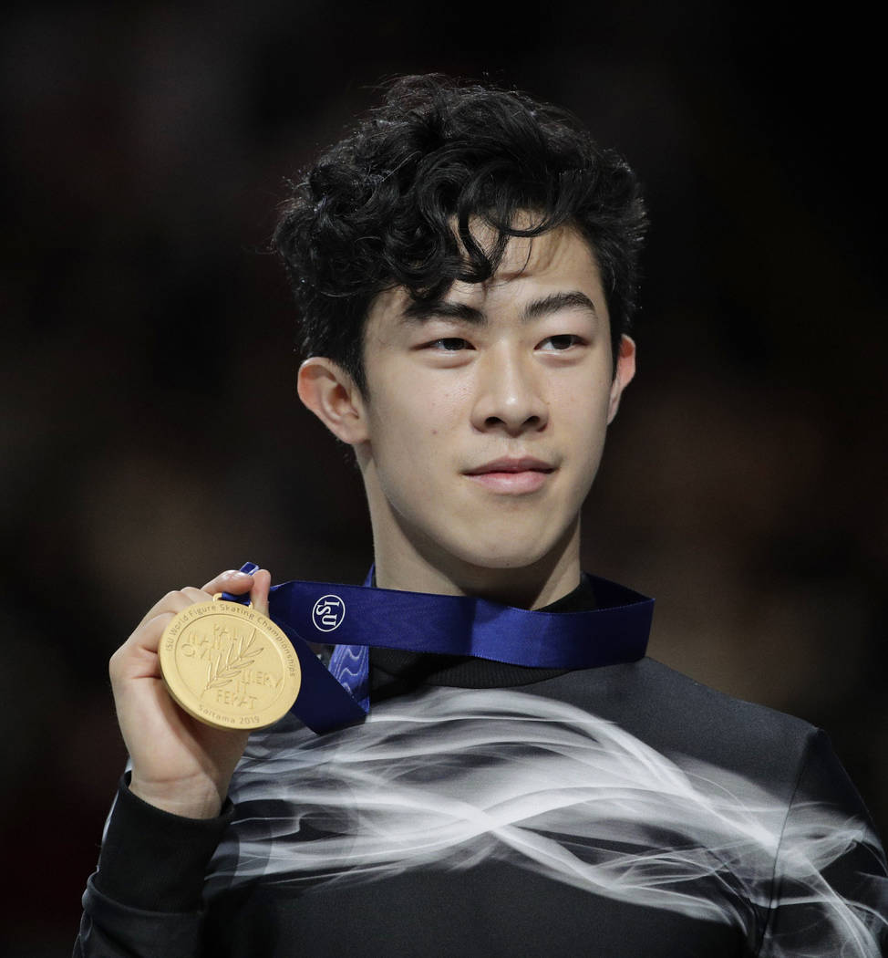


Competitors
Eileen Gu
Born & raised in the U.S.
Single, immigrant Mother from China
Competes for China since 2019 as a Skier
Nathan Chen
Born & raised in the U.S.
Parents immigrated from China
Competes for U.S. as a Figure Skater

Slide 3
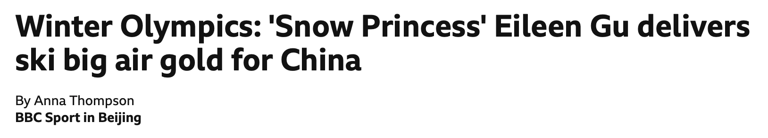
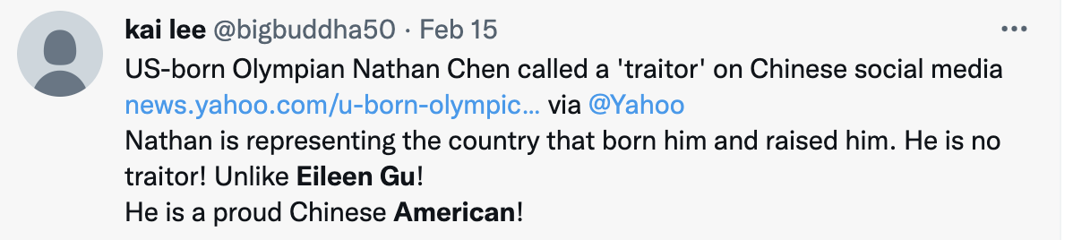
Is there a Double Standard?
Eileen Gu
Received in China as the “Snow Princess” after her win
Many in U.S. skeptical of her dual identity as Chinese & American
Criticized in the U.S. for using her American training to benefit China
Nathan Chen
Received in the U.S. as a champion
Poster boy for the U.S. Olympic Team
Many in China critical of his “traitorship” for competing for the U.S.

Slide 4
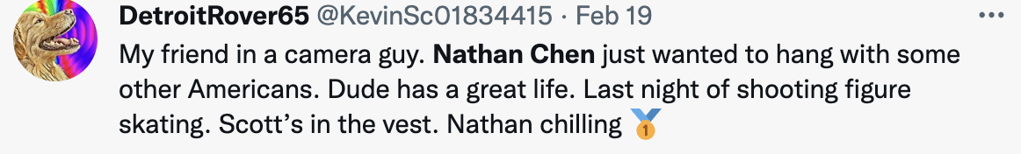
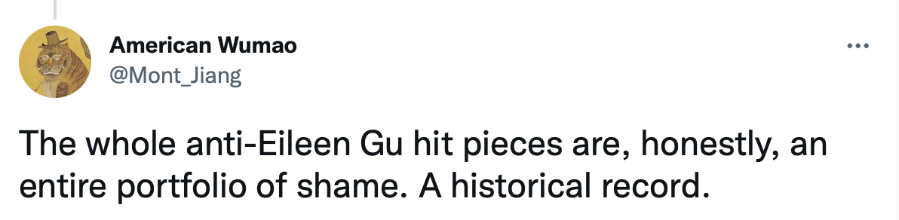
Objective
Compare discussion on social media surrounding the two Olympians
Determine if the sentiments are driven by influencers

Slide 5






Data Collection and Pre-processing
Scraped 60,000 tweets about Eileen Gu and Nathan Chen
Filtered out tweets that are not in English
Removed emoticons, links, stopwords, and words shorter than 3 characters
Converted every word in the tweet to lowercase
Stemmed each word

Slide 6



Chen – Sentiment Analysis and Topic Modeling
3652
10929
Asian, Hate, Chloe Kim
Racism
American, Chinese
Winter, Olympics
Practice, Costumes
Gold, Win
Skater, Quad
Support, Fans

Slide 7
Gu – Sentiment Analysis and Topic Modeling
5434
9770
Racist, Mainstream, Media
China, Chinese
Gold, Win, Ski
China, Censorship, Genocide
Feminism, Woman
Citizenship, American
Compete, Olympics
Woman
Support, Fans

Slide 8
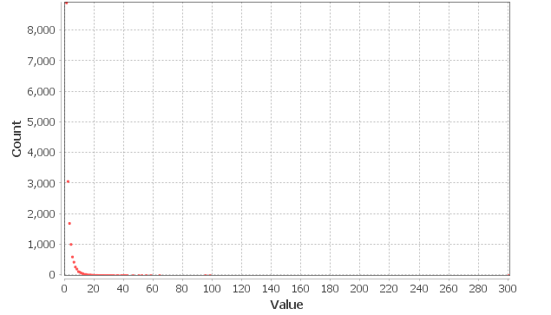
Gu – Degree Distribution
Avg Degree = 1.264

Slide 9
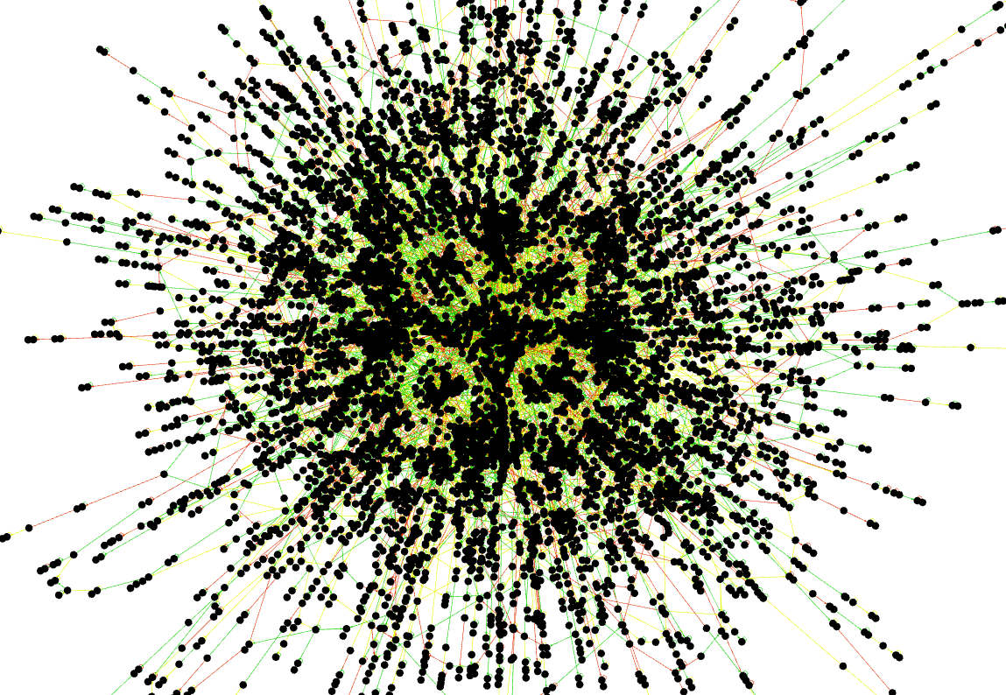
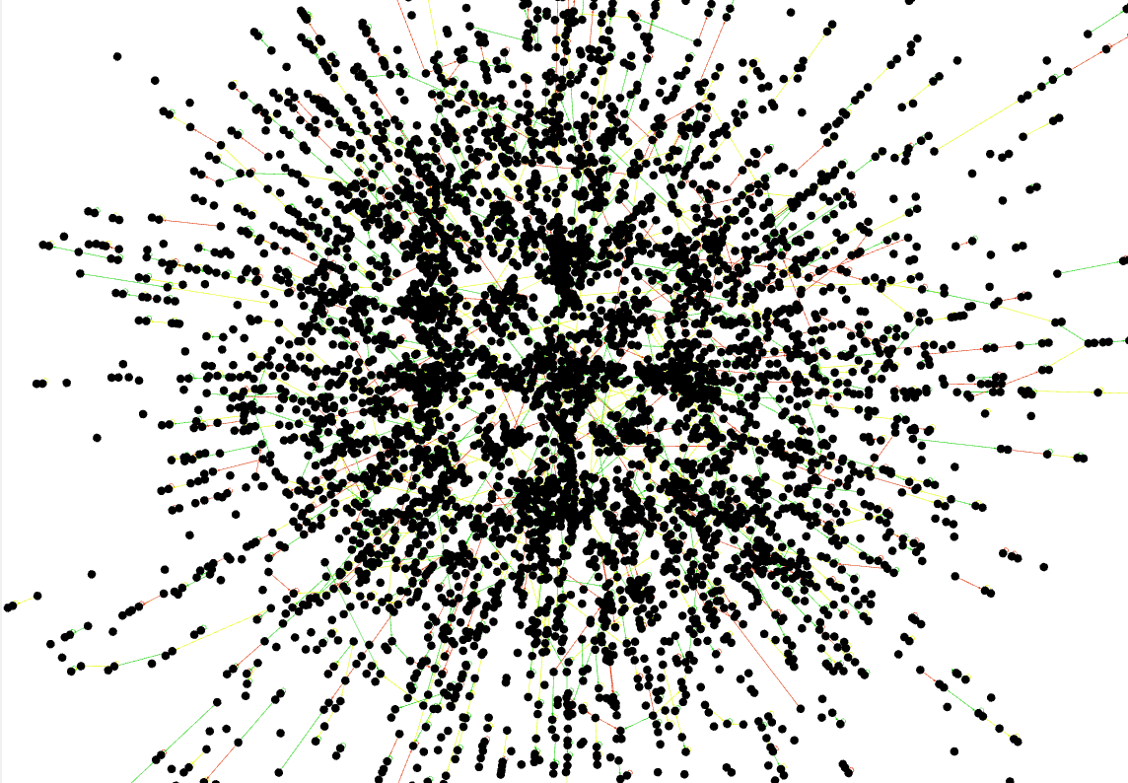
Gu – Grassroots-Driven Network
Considering all network members (max degree = 300)
Considering network members with degree <=5

Slide 10
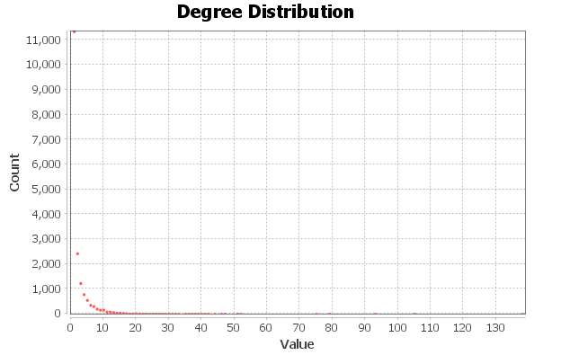
Chen– Degree Distribution
Avg Degree = 1.222

Slide 11
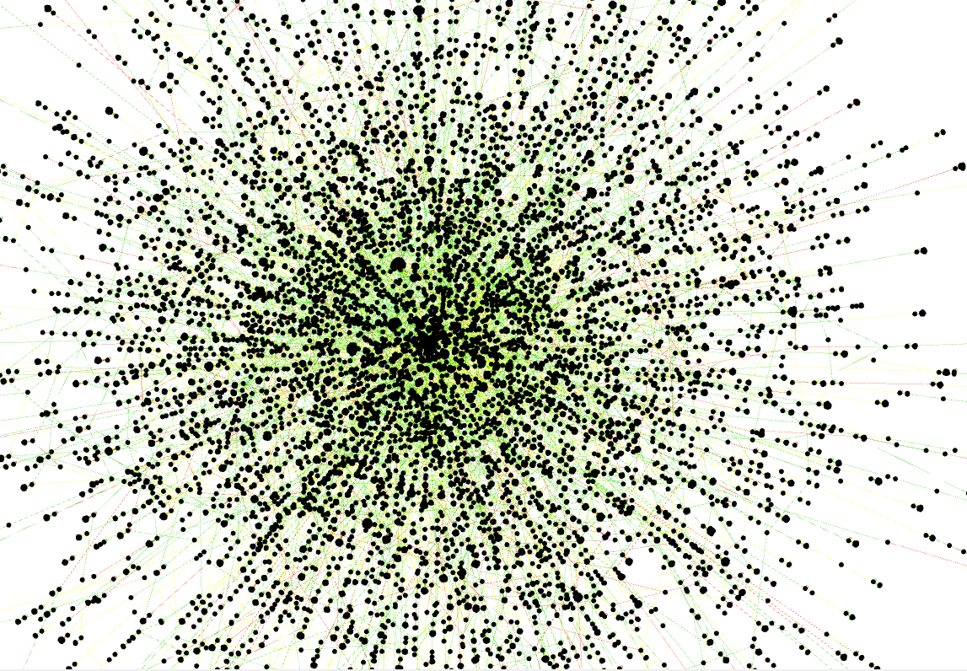
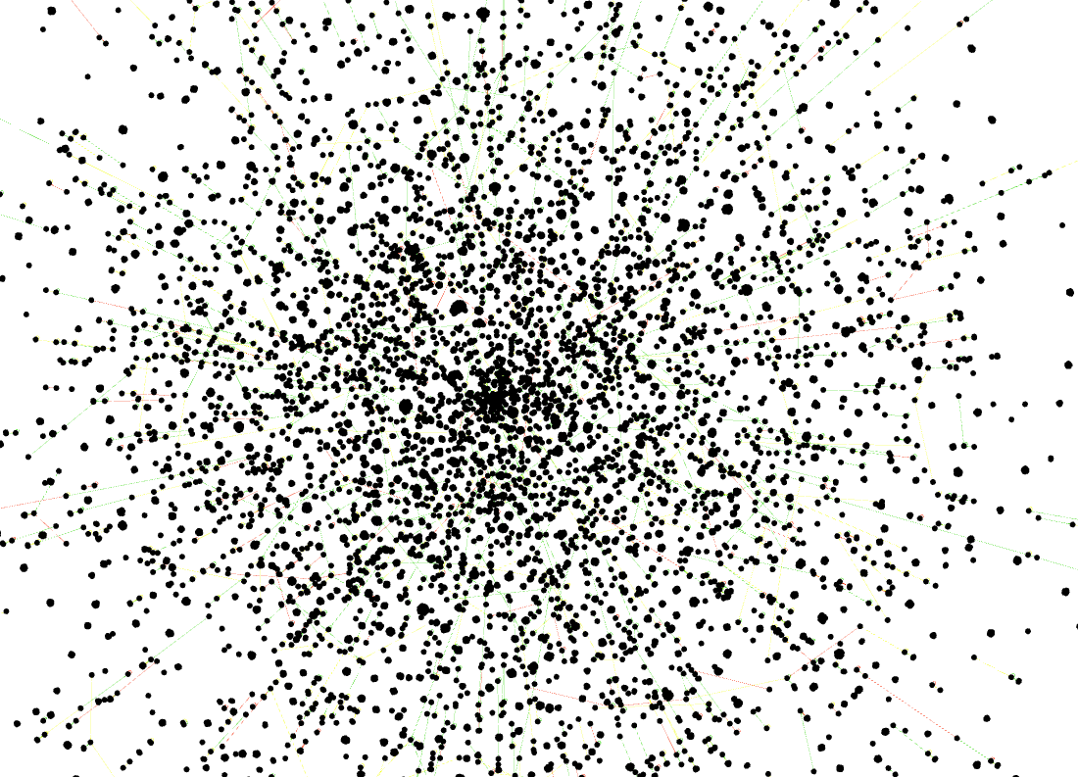
Chen – Grassroots-Driven Network
Considering all network members (max degree = 300)
Considering network members with degree <=5

Slide 12

Key Takeaways
Both athletes have grassroots-driven network
Negative tweets about Gu: Media Coverage + Chinese Govt. actions
Gu NOT unmarketable in the USA
Eileen Gu’s “Be Who You Are” campaign with Oakley

Slide 13

THANK YOU! QUESTIONS?

